Slide 1

RadarID
RADAR-BASED USER IDENTIFICATION IN SMART ENVIRONMENTS
TEAM 5
Francisco Gonçalves
Guilherme Santos
Hugo Rodrigues
João Gaspar
Ricardo Dias
Sérgio Correia
Supervised by Dr.ª Ana Rocha, Dr.º Samuel Silva
PECI 2023/2024

Slide 2
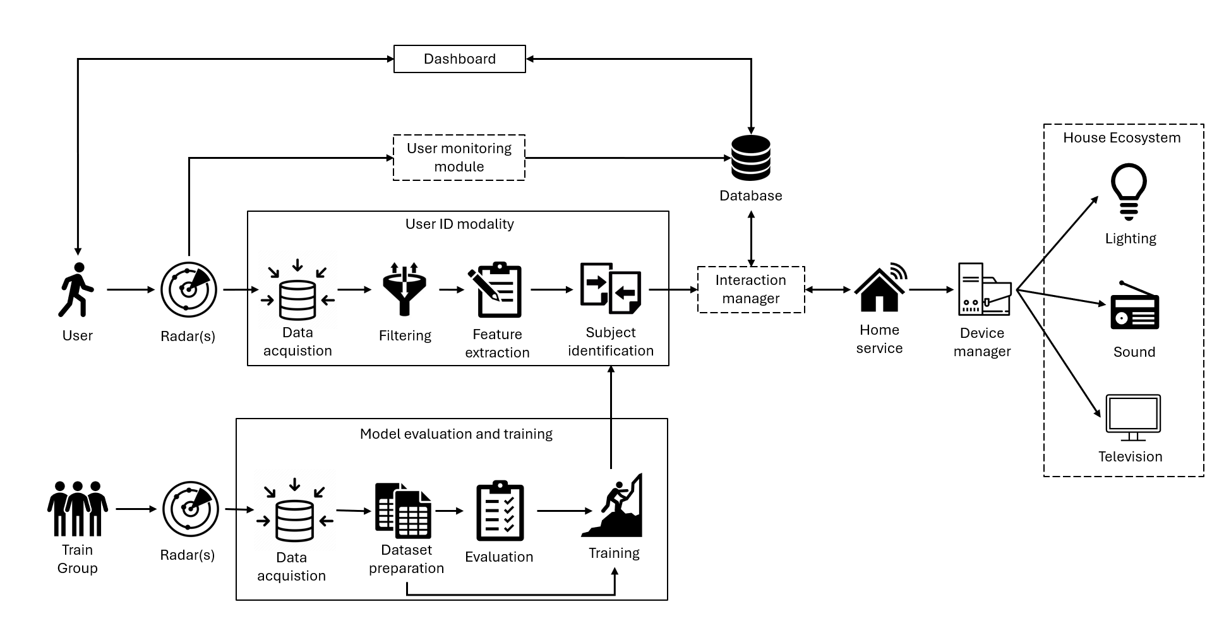
System Overview
Primary Focuses:
User ID Modality
Model Evaluation and Training
Secondary Focus:
Simple interface for a dashboard as a proof of concept for user adaptation

Slide 3
User Identification Modality
Data Acquisition
Data Filtering
Feature Extraction
Subject Identification
Receives raw radar data (TLV packets), parses them, and extracts essential information: 3D position and velocity (Doppler) of moving targets.
A sliding window is used to process the resulting information.
First step consists of filtering: remove some noise, namely by discarding targets with velocity <1e-5 m/s.
Extraction of features from filtered radar data:
Matrix associated to the heat map for each data type (X, Y, Z, Doppler) versus the elapsed time
Vertical concatenation of matrices
Resulting matrix converted to greyscale image.
Relies on a model for subject identification, which given a feature (greyscale image) outputs a user ID/name.
Model previously trained using Transfer Learning and a dataset corresponding to the subjects to be identified.

Slide 4
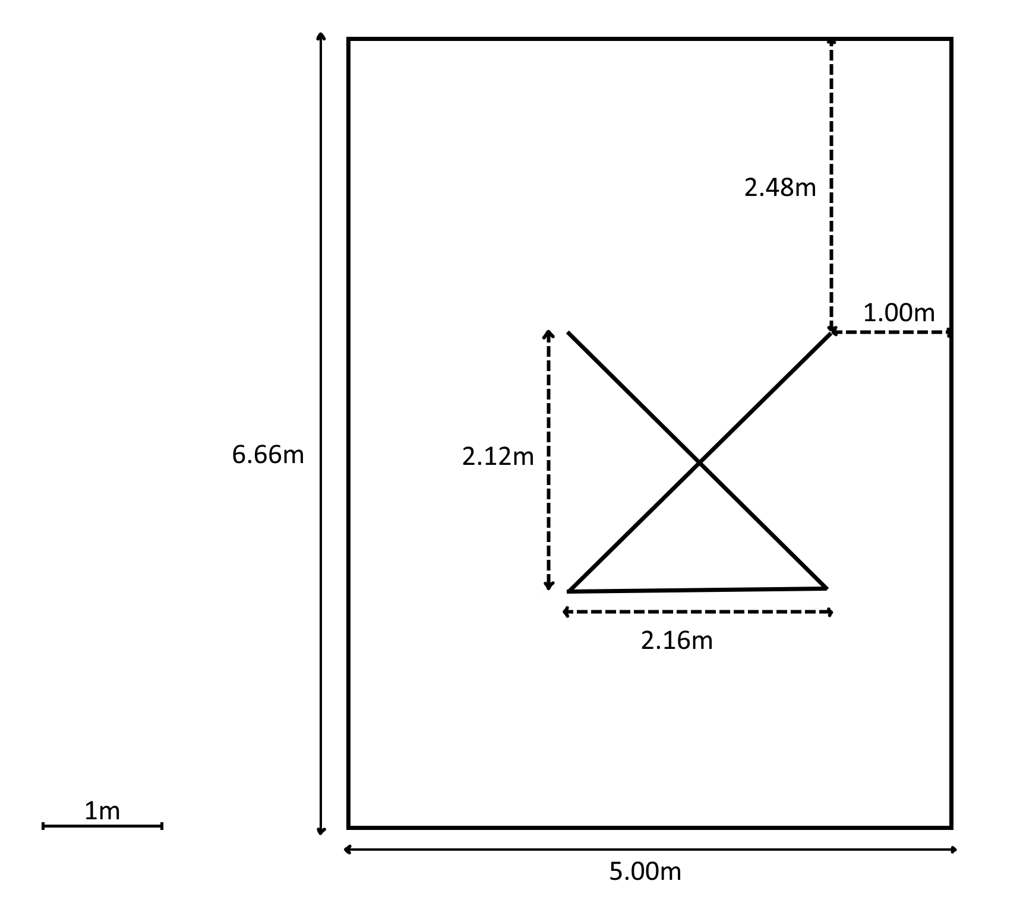
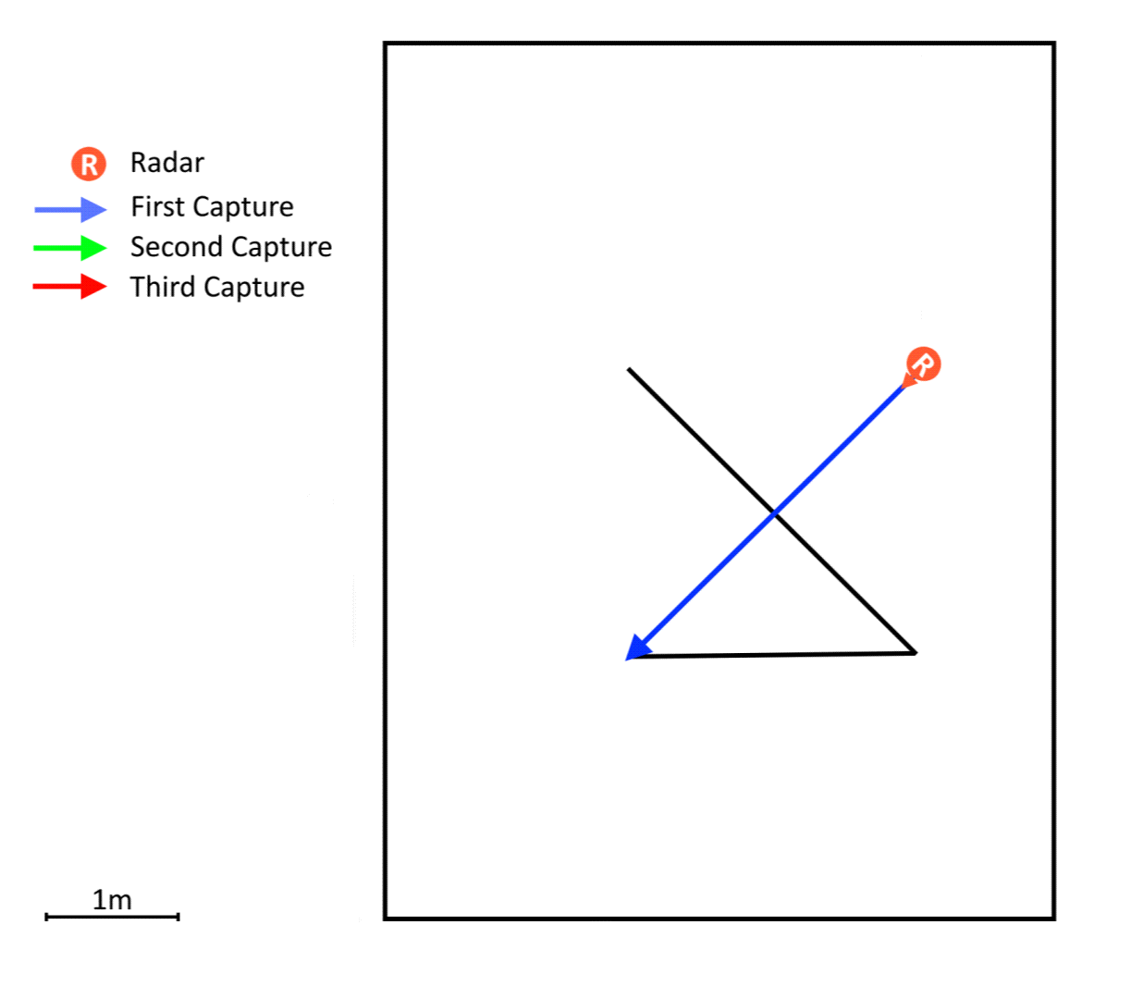
Setup, Protocol and Participants
Participants:
Seven male subjects were involved in the study aged between 20 and 21 years.
Protocol:
Three distinct trajectories, each aligned with the radar orientation:
Parallel
Mixed (Perpendicular, diagonal & parallel)
Perpendicular

Slide 5
Evaluation Approach
Transfer Learning:
We used Transfer Learning by retraining the final layers of a pre-trained image classification model with our dataset, obtained by extracting features from the acquired radar data
Pre-trained Model: MobileNetV2
Same parameters as in previous group work at IEETA
Cross-Validation:
Stratified 10-fold cross-validation
In each iteration, 80% of the data used for training, 10% for validation, and 10% for testing.
Performance Metrics:
Balanced Accuracy
Weighted Average F1 Score

Slide 6
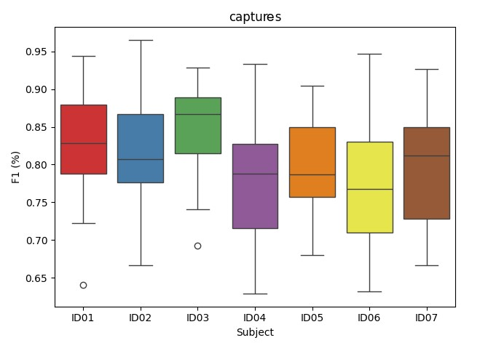
Results for 7 ID's
Participants: Seven subjects
Trajectories:
Parallel
Mixed (Perpendicular, diagonal & parallel)
Perpendicular
Figure 1: F1 score for each subject performing all 3 trajectories

Slide 7
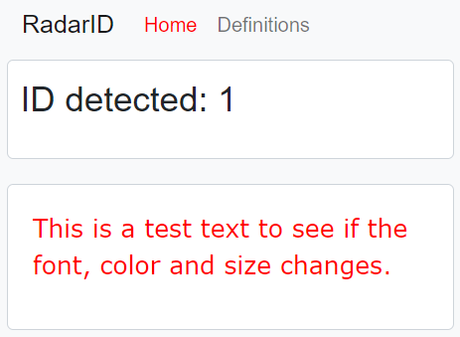
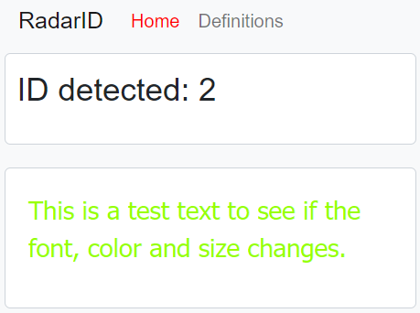
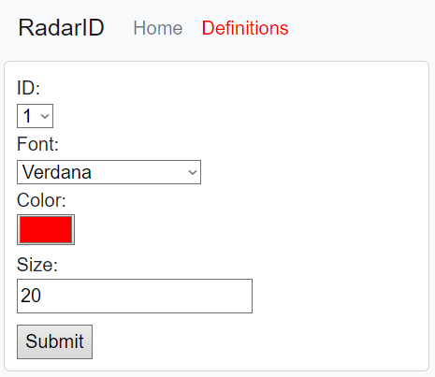
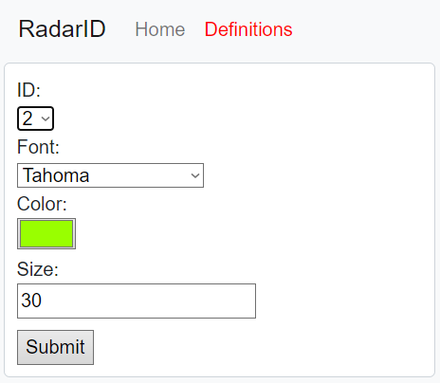
Adaptation to the User (Dashboard)

Slide 8
Conclusions
Proposed and developed a solution exploring radar data to test its applicability for user identification.
Explored the application of ML and TL techniques to comply with low data scenarios.
Implementing a demonstrator consisting of a simple interface that adapts to the current identified user.
The obtained results (with an accuracy ranging from 70.8% to 94.4%) show the potential of using radar data together with machine/transfer learning techniques to perform subject identification in smart environments.
Although different challenges remain, our study already provides relevant and useful information that informs future research.

